Slide 1
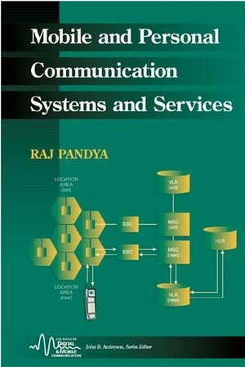
Part - III Principles of Electronic Communication
Chapter- 10
Introduction to Mobile Communication
Reference:
Raj Pandya, “Mobile And Personal
Communication Services And Systems”,
Wiley-IEEE Press,1999

Slide 2
Module-1: Introduction to Mobile Communication
Objectives:
To describe principle behind cellular mobile communication
To Explain the various multiple access techniques used in cellular systems
To discuss the GSM Architecture

Slide 3
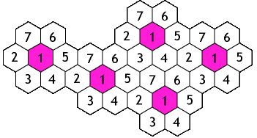
Introduction to Mobile Communication
Adds mobility
Frequency reuse
Basic cellular system

Slide 4
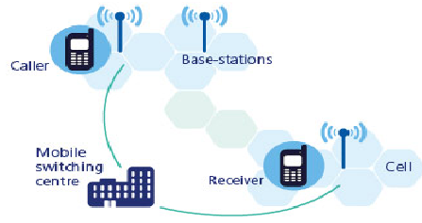
Introduction to Mobile Communication
Mobile phone networks are divided into thousands of overlapping, individual geographic areas or cells each with a Base station
Each mobile communicates via radio with one or more base stations
Each mobile contains a transceiver (transmitter and receiver), an antenna, and control circuitry

Slide 5
Introduction to Mobile Communication
Uplink channel
Downlink channel
Forward and reverse control channel
Hand off
Roaming

Slide 6
Multiple access techniques
Notes:
The three basic multiple access methods in cellular systems are
Frequency division multiple access(FDMA)
Time division multiple access(TDMA)
Code division multiple access(CDMA)
In case of FDMA, users share the available spectrum in the frequency domain, and a user is allocated a part of the frequency band called the traffic channel.
In TDMA techniques that are utilized in many digital cellular systems, the available spectrum is partitioned into narrow frequency bands ,which in turn are divided into a number of time slots. An individual user is assigned a time slot that permits access to the frequency channel for the duration of the time slot.
The CDMA systems utilizes the spread spectrum technique, whereby a spreading code(Pseudo –random noise code or PN code) is used to allow multiple users to share a block of frequency spectrum.

Slide 7
Multiple access techniques
Source: Mobile and Personal communication systems and services by Raj Pandya

Slide 8

Mobile Devices
Pager
receive only
tiny displays
simple text messages
PDA
simple graphical displays
character recognition
simplified WWW
Laptop
fully functional
standard applications
Sensors,
embedded
controllers
Mobile phones
voice, data
simple text displays
Palmtop
tiny keyboard
simple versions of standard applications

Slide 9
Global System for Mobile Communications
Features:
Higher digital voice quality
Low cost alternatives to making calls such as SMS
Ability to deploy equipment from different vendors
GSM allows network operators to offer roaming services

Slide 10
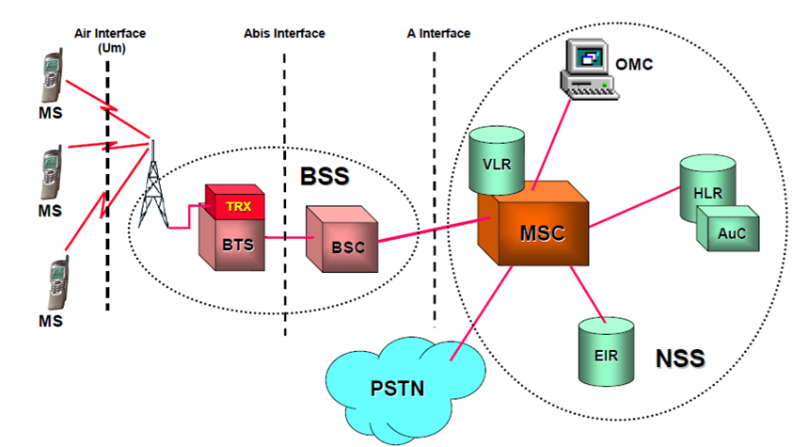
GSM Architecture
Notes:
Mobile Station (MS) : The Mobile Station is made up of two entities:
Mobile Equipment (ME) :
The Mobile Equipment is the hardware used by the subscriber to access the
network .
Uniquely identified by an IMEI (International Mobile Equipment Identity)
2. Subscriber Identity Module (SIM) :
Smart card containing the International Mobile Subscriber Identity (IMSI)
Allows user to send and receive calls and receive other subscribed services
Protected by a password or PIN
Base Station Subsystem:
Base Station Subsystem is composed of two parts :
Base Transceiver Station (BTS)
Base Station Controller (BSC)
Base Transceiver Station (BTS): Houses the radio transceivers that define a cell and handles radio-link protocols with the Mobile Station
Base Station Controller(BSC): The tasks performed by BSC are
Manages Resources for BTS
Handles call set up
Location update
Handover for each MS
Network subsystem(NSS): The NSS provides the link between the cellular network and the public switched telephone network (PSTN). The NSS controls handoffs between cells in different BSSs, authenticates users and validates their accounts, and includes functions for enabling worldwide roaming of mobile users.

Slide 11
GSM Architecture
Mobile Equipment (ME)
Subscriber Identity Module (SIM)
Mobile Station(MS):
Base Station Subsystem (BSS):
Base Transceiver Station (BTS)
Base Station Controller (BSC)
Mobile Switching Center (MSC)
Home Location Register (HLR)
Visitor Location Register (VLR)
Authentication Center (AUC)
Equipment Identity Register (EIR)
Network Subsystem(NSS):
Notes:
Mobile Switching Center(MSC):
The central component of the Network Subsystem
Handles billing activities
Handover management
Communication with HLR,VLR,MSC’S
Controlling of connected BSC’S
Home Location Registers (HLR): The HLR stores information, both permanent and temporary, about each of the subscribers that “belongs” to it. It is the most important database
Visitor Location Registers (VLR): The VLR maintains information about subscribers that are currently physically in the region covered by the switching center.
Authentication Center (AuC): This database is used for authentication activities of the system; for example, it holds the authentication and encryption keys for all the subscribers in both the home and visitor location registers.
Equipment Identity Register (EIR): The EIR keeps track of the type of equipment that exits at the mobile station. It also plays a role in security e.g., blocking calls from stolen mobile stations and preventing use of the network by stations that have not been approved.

Slide 12
Summary
In this module we have learnt:
Basic concept of cellular mobile communication
Commonly used multiple access techniques in cellular systems such as frequency division multiple access, time division multiple access and code division multiple access
Architecture of GSM system
Importance of base station subsystem and network subsystem
The components of network subsystem such as HLR, VLR, AuC and EIR

Slide 13
Self test
How call set up takes place between two mobile subscribers?
Explain the need for cellular concept in mobile communication.
Explain frequency reuse concept in cellular systems.

Slide 14
Exercises
Compare different generations of cellular mobile communication in terms of underlying modulation schemes, data rate, and applications offered etc.
Compare CDMA with that of GSM system.

